Slide 1


Reinforcement Learning
By Nicholas Page 221270355

Slide 2


Contents
Taxi problem
Cart-pole problem
Cliff walking problem

Slide 3
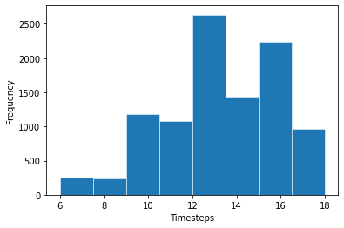
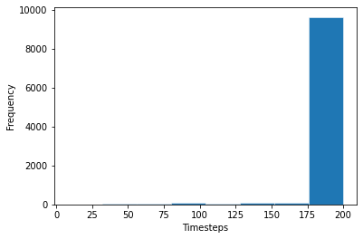
Taxi problem
Q Learning agent over 10000 episodes after 100000 training episodes
TD Learning agent over 10000 episodes

Slide 4
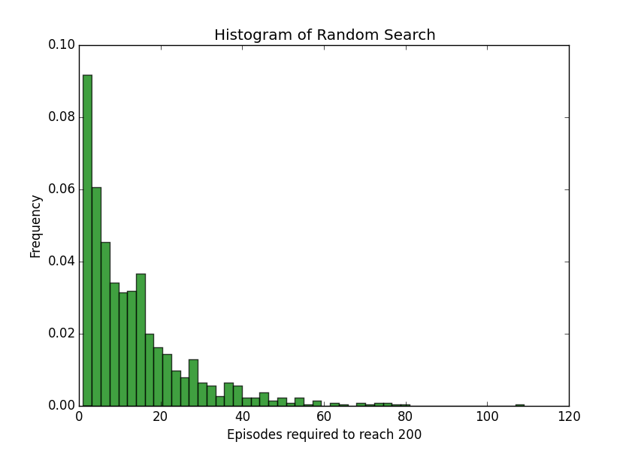
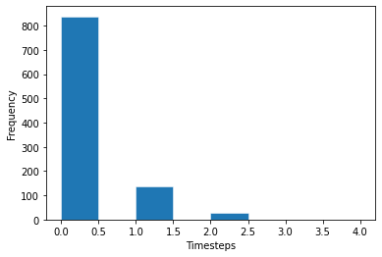
Cart-Pole Problem
Random agent over 1000 episodes, taken from kvfrans.com
Q learning agent over 1000 episodes after 60000 training episodes

Slide 5
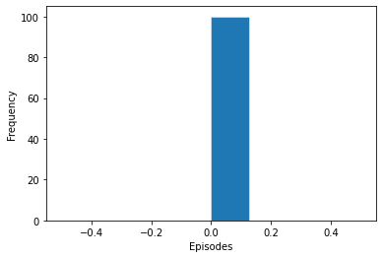
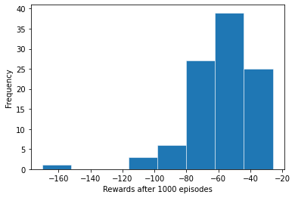
Cliff Walking Problem
Q learning agent over 100 runs after 1000 training episodes to get optimal path. Finds optimal path on first episode every run
TD learning agent over 100 runs. Is not able to get optimal path

Slide 6
Thank you

